Slide 1
LOAN CREDIT RISK ANALYTICS
Credit Eda Loan Case Study
Submitted By:
GURPREET KAUR
DSC43

Slide 2
BUSINESS OBJECTIVES
This Credit EDA Loan Case Study aims of applying EDA in a real business scenario. Our Analysis will assist the Financial Organization in making a LOAN APPROVAL DECISION for the applicant. This might help the Bank/ Financial company control its losses and avert financial losses.
By Applying Credit Risk Analytics Techniques in banking and financial services to minimize the risk of losing money while lending to customers.
In this case study, we will use EDA to understand how Consumer Attributes and Loan Attributes influence the tendency of default.
This case study aims to identify Patterns/ Strong Driving Factors behind loan default which indicate if a client has difficulty paying their installments which may be used for taking actions such as denying the loan, reducing the amount of loan, lending (to risky applicants) at a higher interest rate, etc. This will ensure that the consumers capable of repaying the loan are not rejected. Identification of such applicants using EDA is the aim of this case study.

Slide 3
PROBLEM STATEMENT
Two types of risks are associated with the bank’s/Financial Organization decision for Loan Approval:
If the applicant is likely to repay the loan, then not approving the loan results in a loss of business to the company.
If the applicant is not likely to repay the loan, i.e. he/she is likely to default, then approving the loan may lead to a financial loss for the company.
Identification of such applicants & Strong Defaulter Driving Patterns using EDA is the aim of this case study.

Slide 4
EDA APPROACH
OF “CURRENT APPLICATION” DATASET
OF “MERGED DATASET”
PREVIOUS & CURRENT APPLICATION
Dataset Inspection (Data Understanding)
Data Imbalance Check
Data Cleaning, Manipulation & Analysis
Transformation Of Dates (Days, Quarter, Years)
Missing Value Analysis
Imputation in Missing Value Analysis
Outliers Analysis
Univariate Analysis Of Categorical Columns
Univariate Analysis of Numerical Columns
Segmented Univariate Analysis
Bivariate Analysis
Top 10 Correlated Columns (CORR)
Data Reading & Dataset Inspection Of Previous Application Dataset
Merging Previous-Application dataset with Current-Application dataset
Data Cleaning, Manipulation & Analysis
Transformation Of Dates (Days, Quarter, Years) of Merged Dataset
Missing Value Analysis of Merged Dataset
Univariate Analysis Of Categorical Columns Of Merged Dataset
Univariate Analysis of Numerical Columns of Merged Dataset.
Segmented Univariate Analysis Merged Dataset
Bivariate Analysis Of Merged Dataset
Conclusion (Summary) With Strong Indicators To Drive Business Decisions

Slide 5
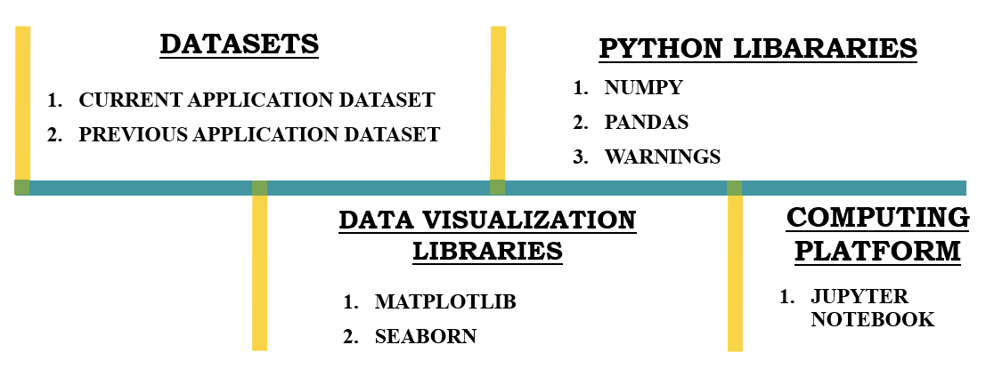
EDA REQUIREMENTS

Slide 6
STRONG INDICATORS TO DRIVE BUSINESS DECISIONS
Target/focused variable for "Current-Application" Dataset : “TARGET”
Target/focused variable for "Previous-Application" Dataset : “NAME_CONTRACT_STATUS”
Top Major variables to consider for loan prediction:
NAME_EDUCATION_TYPE - AMT_INCOME_TOTAL
DAYS_BIRTH - AMT_CREDIT
DAYS_EMPLOYED - AMT_ANNUITY
NAME_INCOME_TYPE - CODE_GENDER
ORGANIZATION_TYPE - REGION_RATING_CLIENT
NAME_HOUSING_TYPE - NAME_CASH_LOAN_PURPOSE
To Minimize risk of loss, the above-mentioned variables should be evaluated before approving an application.

Slide 7
CURRENT ANALYSIS WHO ARE TAKING MORE LOANS?
Secondary/Special Educated People applying for Loans are in Highest No.
People with real estate tends to take more loans
People tend to take more cash loans, and default percentage of revolving loans is less
People who don't own a car tends to take more loans
Female tends to take more loans
Married people tend to take more Loan as compared to other categories.
People with House or Apartment tend to take more loans

Slide 8
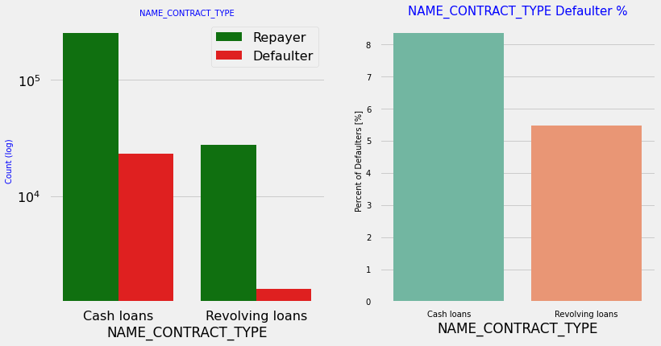
UNIVARIATE CATEGORICAL ANALYSIS Analyzing Contract Type Based On Loan Repayment Status
Inferences:
Contract type: Revolving loans are just a small fraction (10%) from the total number of loans; in the same time, a larger amount of Revolving loans, comparing with their frequency, are not repaid.

Slide 9
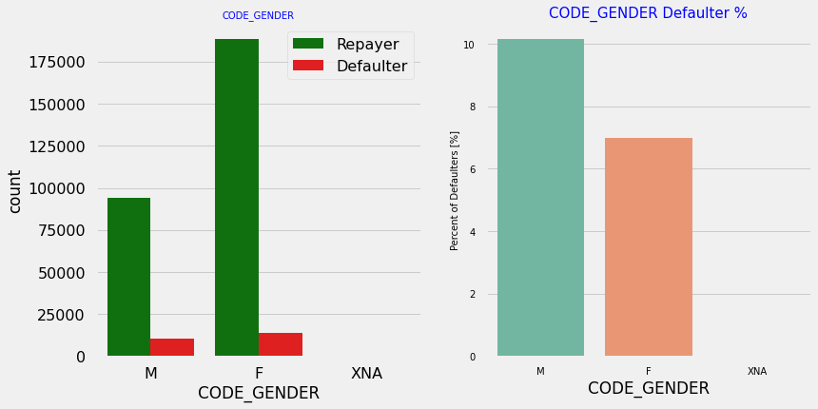
UNIVARIATE CATEGORICAL ANALYSIS Analyzing Type Of Gender Based On Loan Repayment Status
Inferences:
The number of female clients is almost double the number of male clients. Based on the percentage of defaulted credits, males have a higher chance of not returning their loans (~10%), comparing with women (~7%)

Slide 10
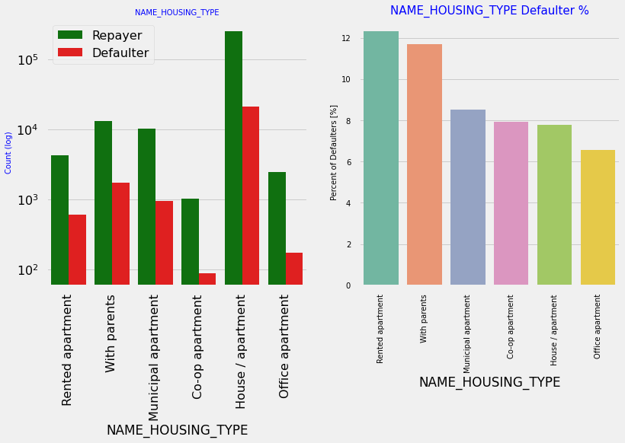
UNIVARIATE CATEGORICAL ANALYSIS Analyzing Housing Type Based On Loan Repayment Status
Inferences:
Majority of people live in House/apartment
People living in office apartments have lowest default rate
People living with parents (~11.5%) and living in rented apartments(>12%) have higher probability of defaulting

Slide 11
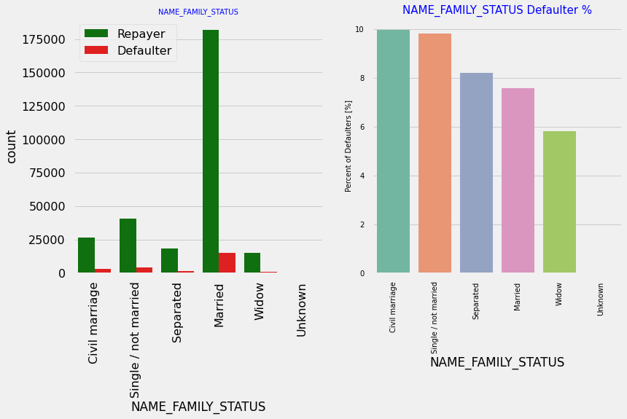
UNIVARIATE CATEGORICAL ANALYSIS Analyzing Family Status Based On Loan Repayment Status
Inferences:
Most of the people who have taken loan are married, followed by Single and civil marriage.
In terms of percentage of not repayment of loan, Civil marriage has the highest percent of not repayment (10%), with Widow the lowest (exception being Unknown).

Slide 12
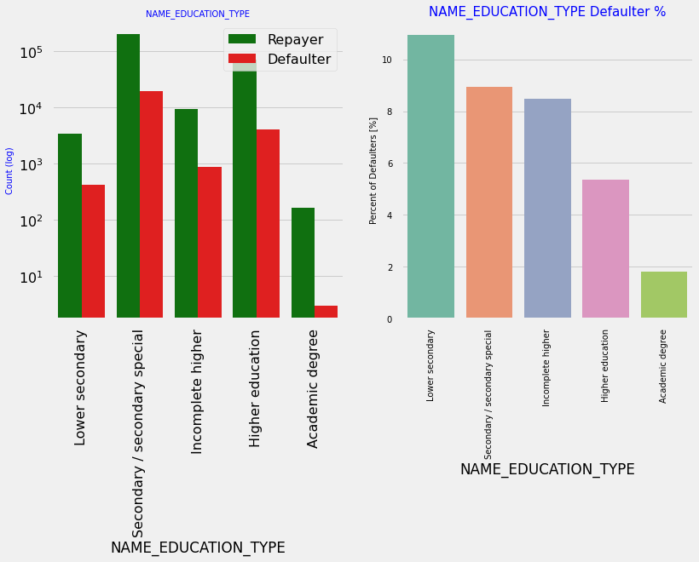
UNIVARIATE CATEGORICAL ANALYSIS Analyzing Education Type Based On Loan Repayment Status
Inferences:
Majority of the clients have Lower Secondary / secondary special education being Highest Defaulters among all.
The people with Academic degree have less than 2% defaulting rate.

Slide 13
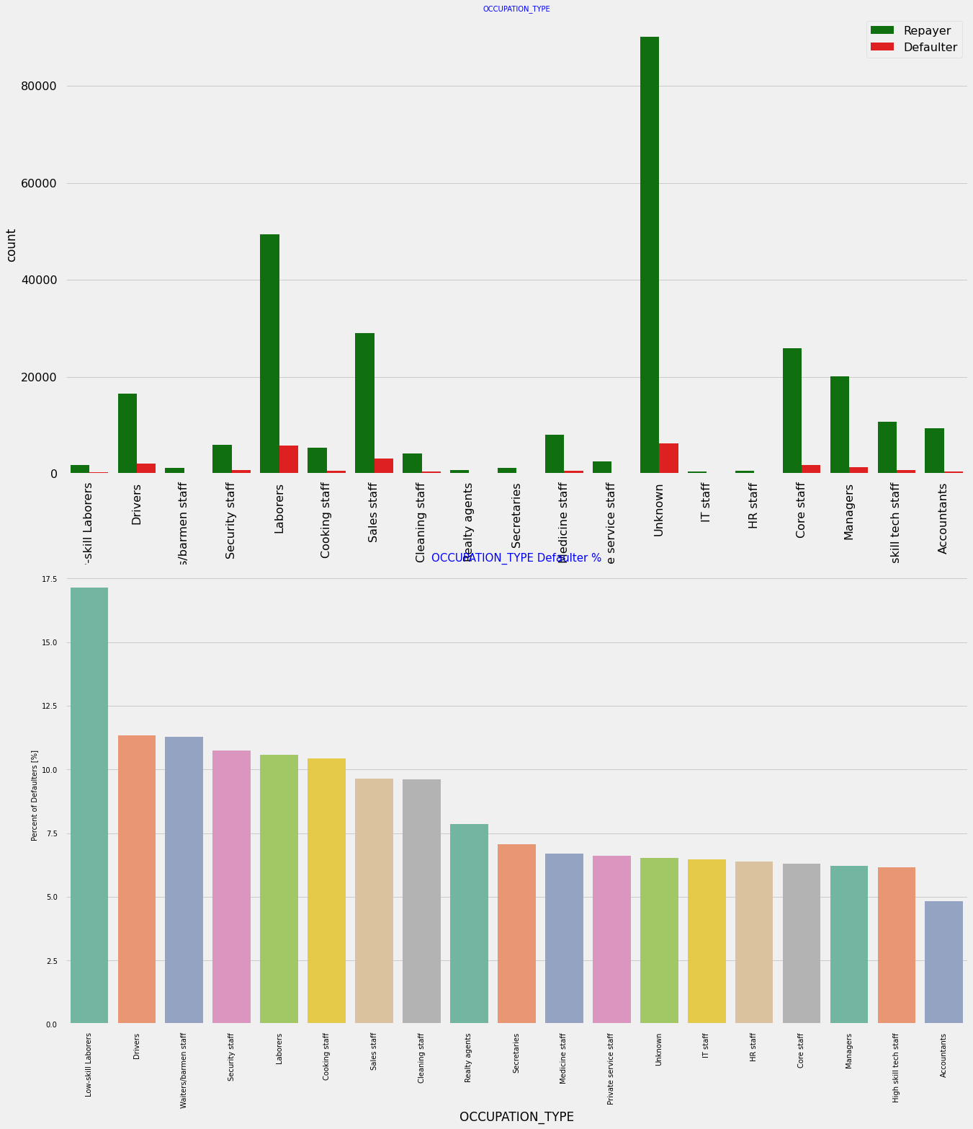
UNIVARIATE CATEGORICAL ANALYSIS Analyzing Occupation Type Based On Loan Repayment Status
Inferences:
Most of the loans are taken by Laborers, followed by Sales staff. IT staff take the lowest amount of loans.
The category with highest percent of not repaid loans are Low-skill Laborers (above 17%), followed by Drivers and Waiters/barmen staff, Security staff, Laborers and Cooking staff.

Slide 14
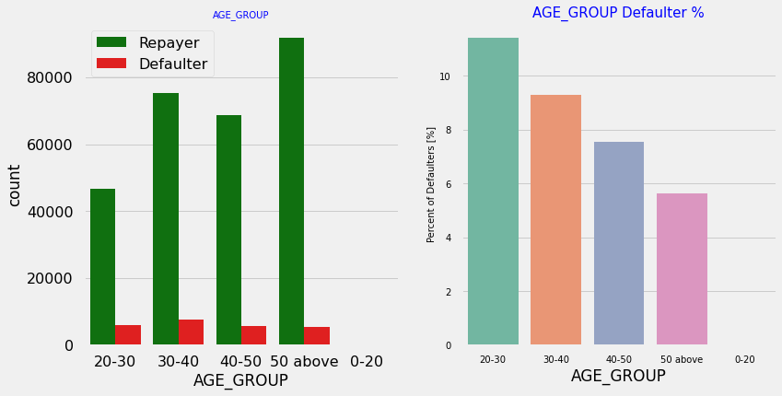
UNIVARIATE CATEGORICAL ANALYSIS Analyzing Age Group Based On Loan Repayment Status
Inferences:
People in the age group range 20-40 have higher probability of defaulting
People above age of 50 have low probability of defaulting

Slide 15
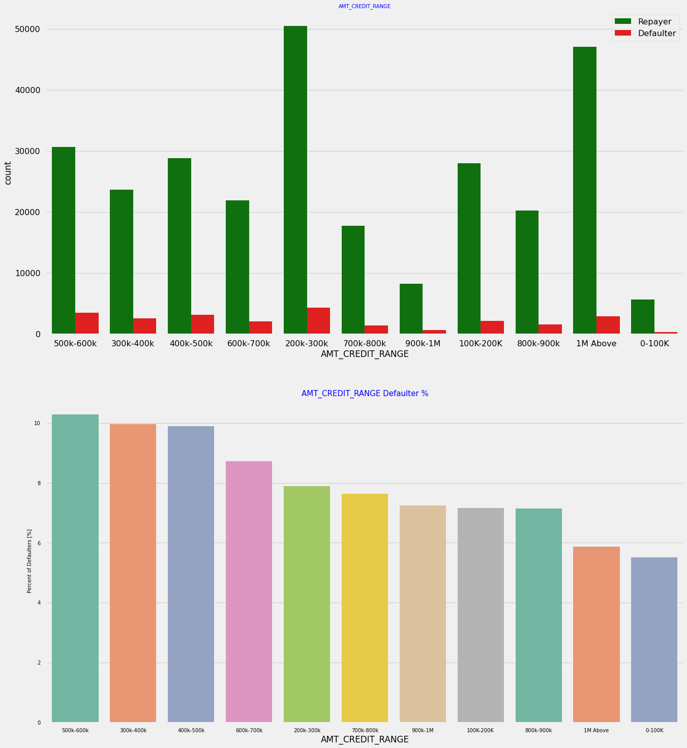
UNIVARIATE NUMERICAL ANALYSIS Analyzing Amount_Credit Based On Loan Repayment Status
Inferences:
More than 80% of the loan provided are for amount less than 900,000
People who get loan for 300-600k tend to default more than others.

Slide 16
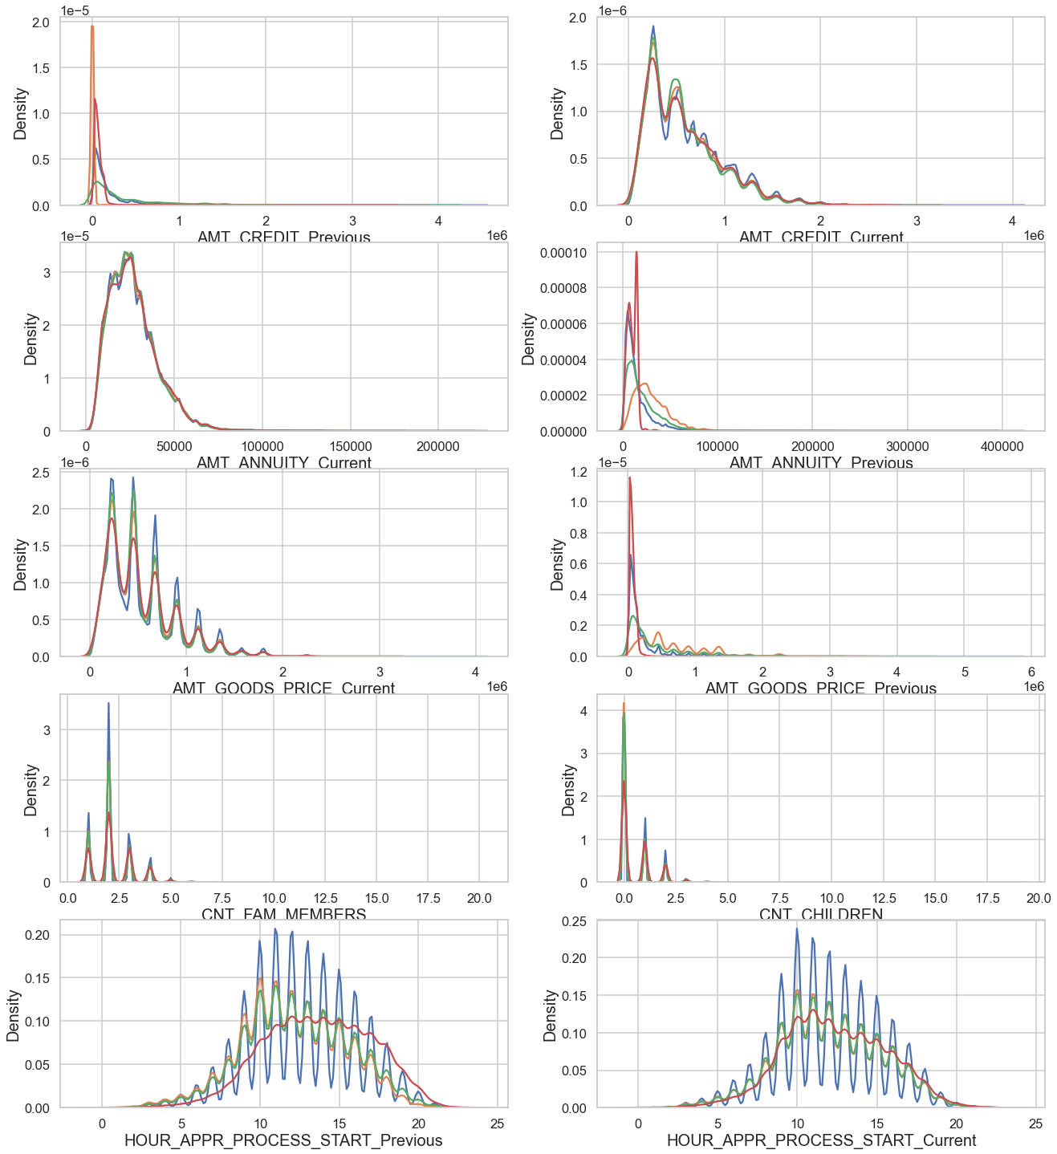
UNIVARIATE NUMERICAL CONTINUOUS ANALYSIS
Inferences:
High number of applications are filed in 9 AM to 2 PM for both Current and Previous data.
So busiest hours for bank are form 9 AM to 2 PM.
nuclear family tends to take more loans.
Previously bank had high unused offers but currently refused is high incase of AMT_GOODS_PRICE.
Previously bank had high unused offers & currently cancelled/refused offers are similar for AMT_ANNUITY.
Previously bank had high unused offers & currently high no. of refused offers for AMT_CREDIT.

Slide 17
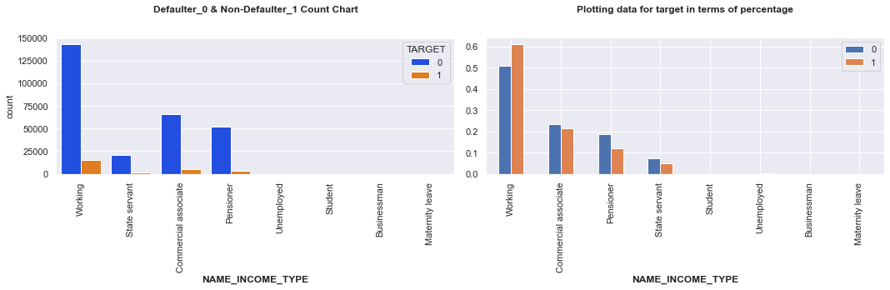
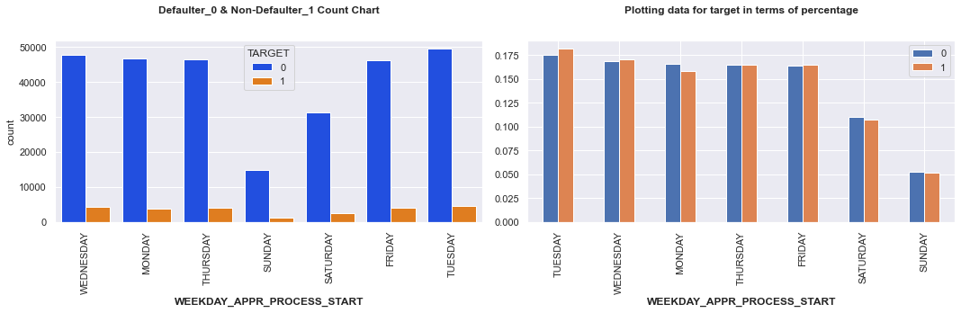
SEGMENTED UNIVARIATE ANALYSIS (Income Type, Week Day wrt Target Defaulters/Non-Defaulters)
Inferences:
People having Medium Total Income are more defaulters.
People having high Credit amount are less defaulters.
People enrolling for application process on Sunday are less likely to default (min defaulters).
Saturday and Sunday are least busiest for bank in terms of loan applications.
Pensioner defaulter is lower than Non-defaulter.

Slide 18
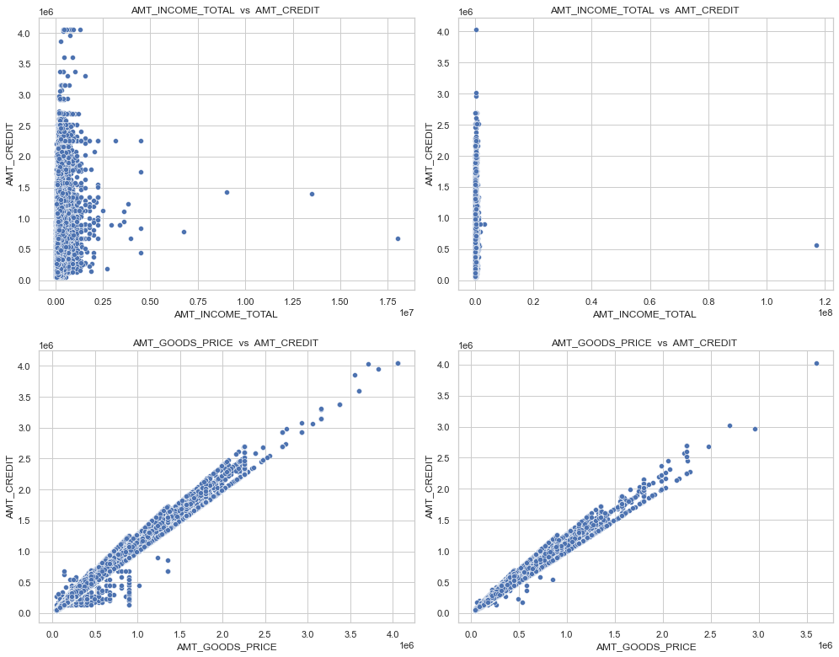
BIVARIATE ANALYSIS OF MERGED DATASET Analyzing Income vs Credit, Goods Price vs Credit
Inferences:
AMT_GOODS_PRICE: When the credit amount goes beyond 3M, there is an increase in defaulters.
AMT_CREDIT: People who get loan for 300-600k tend to default more than others and hence having higher interest specifically for this credit range would be ideal.
AMT_INCOME: Since 90% of the applications have Income total less than 300,000 and they have high probability of defaulting, they could be offered loan with higher interest compared to other income category.

Slide 19
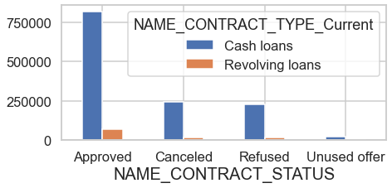
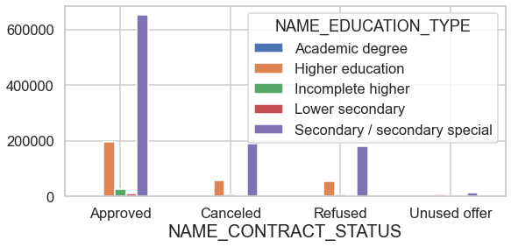
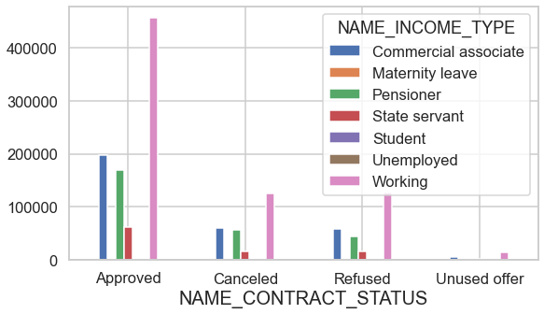
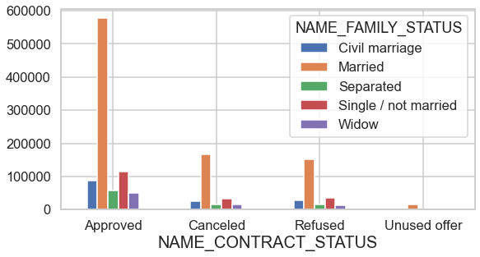
BIVARIATE ANALYSIS OF MERGED DATASET Analyzing Education, Contract ,Income, Family Type with Contract Status
Inferences:
Cash loans has highest count of Approved loans
Working applicant have Highest no. of approvals.
Secondary/Secondary-special-educated applicant have Highest no. of approvals.
Married applicant got Highest number of approvals.

Slide 20
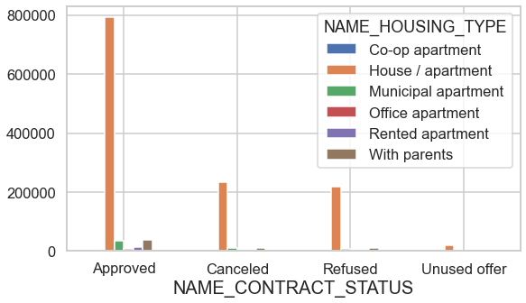
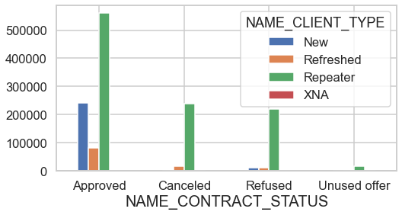
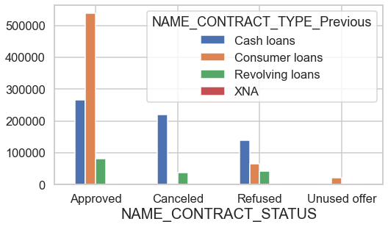
BIVARIATE ANALYSIS OF MERGED DATASET Analyzing Housing Type, Previous Contract, Client Type with Contract Status
Inferences:
House/apartment owner have Highest number of approvals
Consumer Loans have Highest number of approvals.
Most no. of times Repeated Applications got approved.

Slide 21
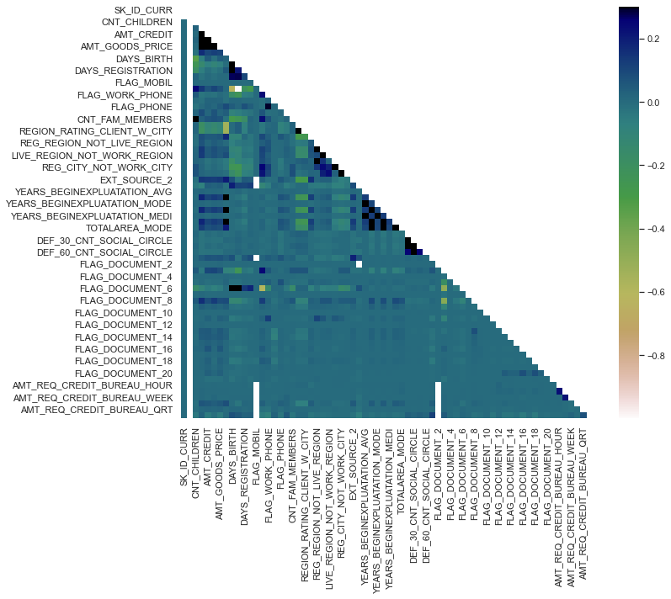
NON - DEFAULTER CORRELATION

Slide 22
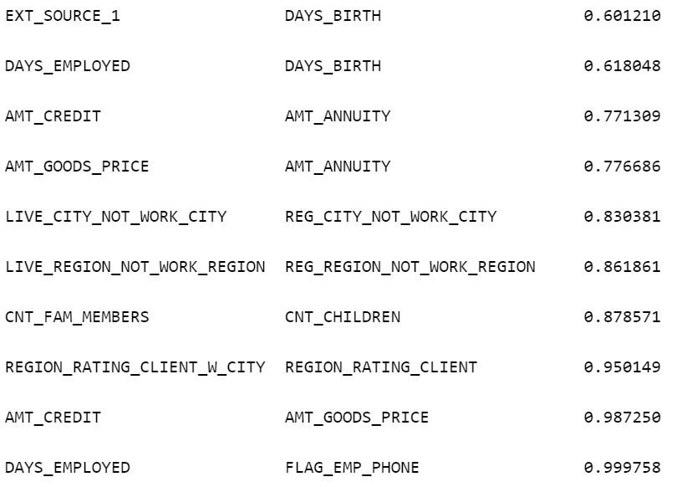
TOP NON - DEFAULTER CORRELATIONS

Slide 23
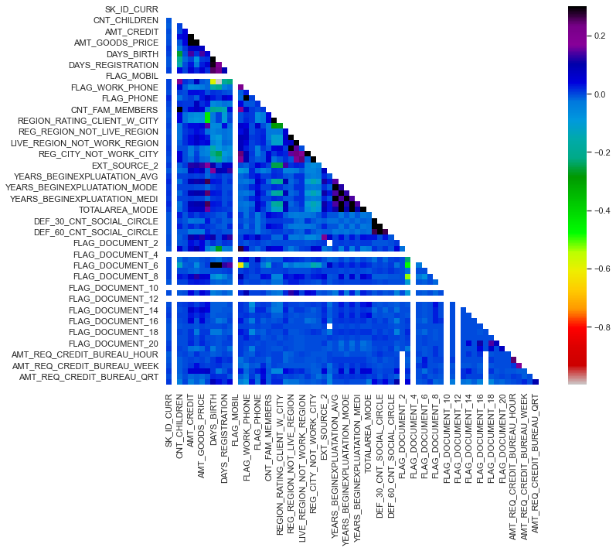
DEFAULTER CORRELATION

Slide 24
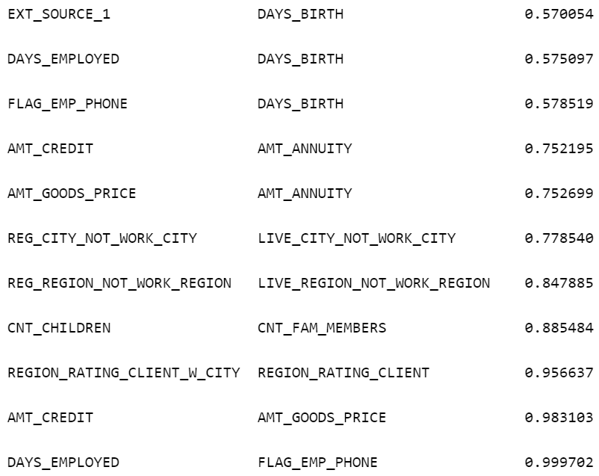
TOP DEFAULTER CORRELATIONS

Slide 25
DECISIVE FACTOR WHETHER AN APPLICANT WILL BE REPAYER
NAME_EDUCATION_TYPE : Academic degree has less defaults.
NAME_INCOME_TYPE : Student and Businessmen have no defaults.
REGION_RATING_CLIENT : RATING 1 is safer.
ORGANIZATION_TYPE : Clients with Trade Type 4 and 5 and Industry type 8 have defaulted less than 3%
DAYS_BIRTH : People above age of 50 have low probability of defaulting
DAYS_EMPLOYED : Clients with 40+ year experience having less than 1% default rate
AMT_INCOME_TOTAL : Applicant with Income more than 700,000 are less likely to default
NAME_CASH_LOAN_PURPOSE : Loans bought for Hobby, Buying garage are being repayed mostly.
CNT_CHILDREN: People with zero to two children tend to repay the loans.

Slide 26


DECISIVE FACTOR WHETHER AN APPLICANT WILL BE DEFAULTER
CODE_GENDER : Men are at relatively higher default rate
NAME_INCOME_TYPE : Clients who are either at Maternity leave OR Unemployed default a lot.
NAME_EDUCATION_TYPE : People with Lower Secondary & Secondary education
REGION_RATING_CLIENT : People who live in Rating 3 has highest defaults.
OCCUPATION_TYPE : Avoid Low-skill Laborers, Drivers and Waiters/barmen staff, Security staff, Laborers and Cooking staff as the default rate is huge.
NAME_FAMILY_STATUS : People who have civil marriage or who are single default a lot.

Slide 27
DECISIVE FACTOR WHETHER AN APPLICANT WILL BE DEFAULTER
DAYS_BIRTH : Avoid young people who are in age group of 20-40 as they have higher probability of defaulting
ORGANIZATION_TYPE : Organizations with highest percent of loans not repaid are Transport: type 3 (16%), Industry: type 13 (13.5%), Industry: type 8 (12.5%) and Restaurant (less than 12%). Self-employed people have relative high defaulting rate, and thus should be avoided to be approved for loan or provide loan with higher interest rate to mitigate the risk of defaulting.
DAYS_EMPLOYED: People who have less than 5 years of employment have high default rate.
CNT_CHILDREN & CNT_FAM_MEMBERS : Client who have children equal to or more than 9 default 100% and hence their applications are to be rejected.
AMT_GOODS_PRICE : When the credit amount goes beyond 3M, there is an increase in defaulters.

Slide 28
The following ATTRIBUTES indicate that people from these category tend to default but then due to the number of people and the amount of loan, the bank could provide loan with HIGHER INTEREST TO MITIGATE ANY DEFAULT RISK THUS PREVENTING BUSINESS LOSS :
NAME_HOUSING_TYPE : High number of loan applications are from the category of people who live in Rented apartments & living with parents and hence offering the loan would mitigate the loss if any of those default.
AMT_CREDIT : People who get loan for 300-600k tend to default more than others and hence having higher interest specifically for this credit range would be ideal.
CNT_CHILDREN & CNT_FAM_MEMBERS : Clients who have 4 to 8 children has a very high default rate and hence higher interest should be imposed on their loans.
NAME_CASH_LOAN_PURPOSE : Loan taken for the purpose of Repairs seems to have highest default rate. A very high number applications have been rejected by bank or refused by client in previous applications as well which has purpose as repair or other. This shows that purpose repair is taken as high risk by bank and either they are rejected, or bank offers very high loan interest rate which is not feasible by the clients, thus they refuse the loan. The same approach could be followed in future as well.
AMT_INCOME : Since 90% of the applications have Income total less than 300,000 and they have high probability of defaulting, they could be offered loan with higher interest compared to other income category.

Slide 29
CONCLUSION
TO WHOM SHOULD LOAN CAN BE DISAPPROVED?
(Risky Group Category Of DEFAULTERS)
Lower Secondary Educated Clients are the Highest & Most Riskiest Clients in no. to be Defaulters, especially when their Previous Loans were Cancelled Or Refused.
Male Clients with Civil Marriage
Previously Refused Loan Status Group.
Banks should focus less on the 'Working' Income Type, which has the highest number of failed payments.
People with Medium total income are more likely to default
Considering Loan purpose ‘Repair’ is having Greater No. of Unsuccessful Payments on time.

Slide 30
CONCLUSION
TO WHOM SHOULD LOAN CAN BE APPROVED?
(Recommended Group Category To Have Non-Defaulter)
Banks should focus on 'Students' ,'Pensioner' for successful repayments.
Client with the Higher Income Category.
FEMALE Client with Higher Education.
Clients who are working as STATE Servant.
Old People of any Income Group.
Client’s who’s Previous Loan was Approved.
Old Female Client
For successful payments, banks should focus more on contract types such as "businessman", "pensioner" and "student" with housing types other than "co-op unit.“
Get as much as clients from housing type ‘With parents’ as they have the Fewest Failed Payments.
Repeater has highest number of approved loans.

Slide 31

SUBMITTED BY:
GURPREET KAUR
DSC43

